Slide 1
facebook
scalability
5809610248 nitipat wuttisasiwat

Slide 2

news feed
introduction

Slide 3
scalability
newsfeed
PROBLEM & SOLUTIONS

Slide 4
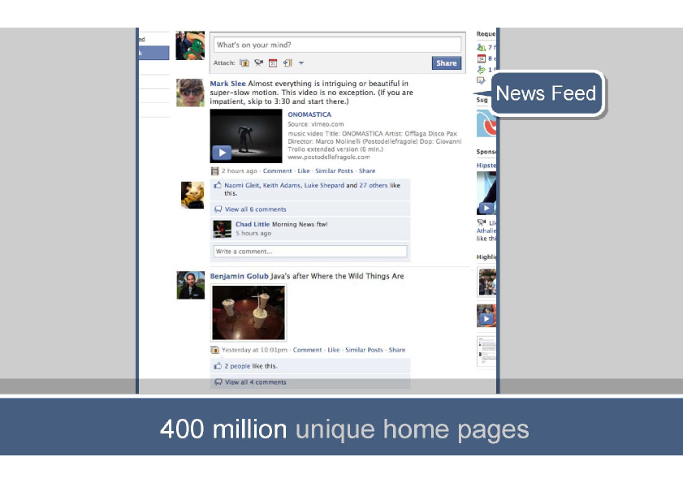

Slide 5
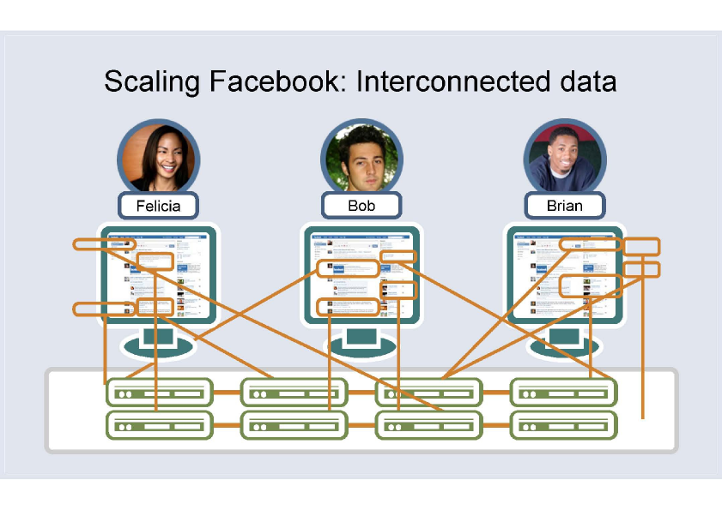

Slide 6
HIPHOP!
SOLUTION #1

Slide 7
solution 1

Slide 8
solution 1

Slide 9
solution 1

Slide 10
DENORMALIZATION!
SOLUTION #2

Slide 11
solution 2

Slide 12
solution 2
DECREASE JOIN OVERHEAD

Slide 13
MEMCACHE!
SOLUTION #3

Slide 14
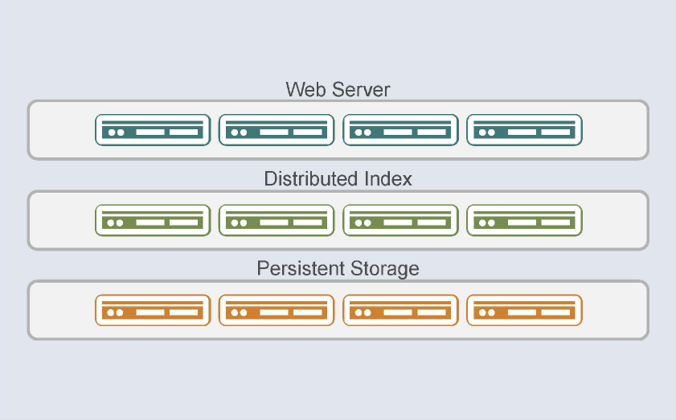
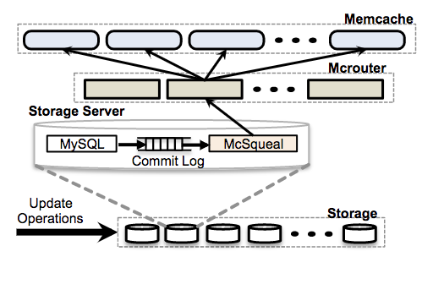
solution 3

Slide 15
solution 3
FASTER!

Slide 16
DISTRIBUTED VIRTUAL FEED STORAGE!
SOLUTION #4

Slide 17
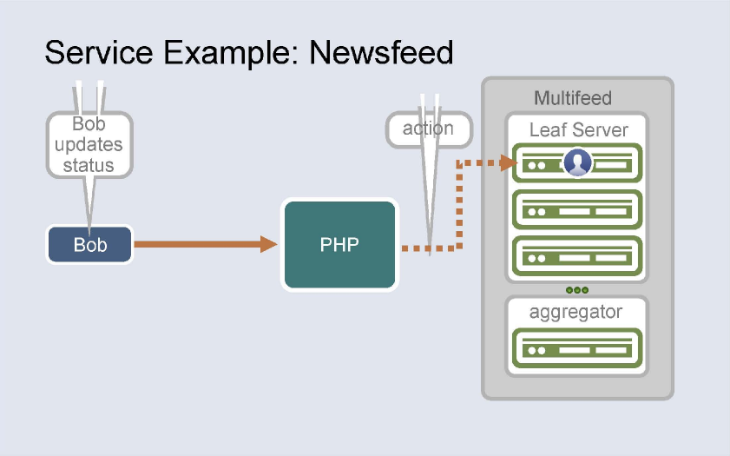
solution 4

Slide 18
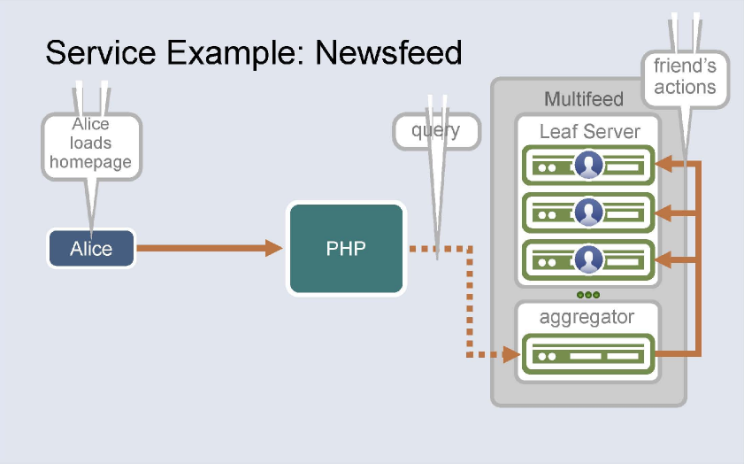
solution 4

Slide 19
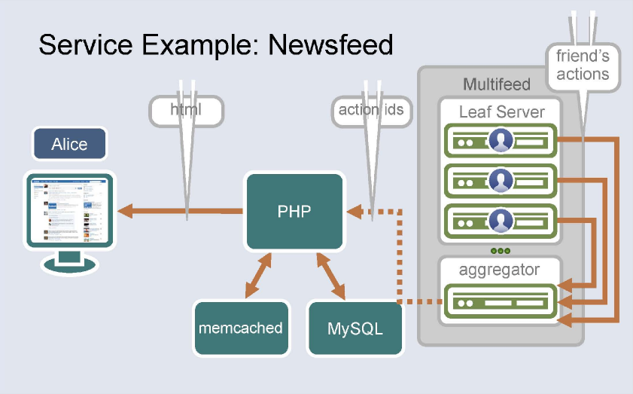
solution 4

Slide 20
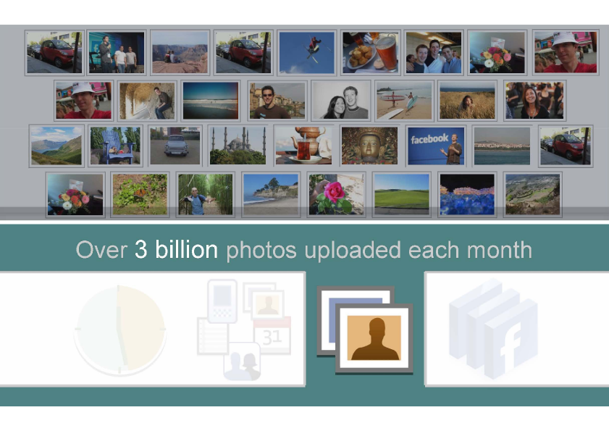

Slide 21
CLOUD DELIVERY NETWORK!
SOLUTION #5

Slide 22
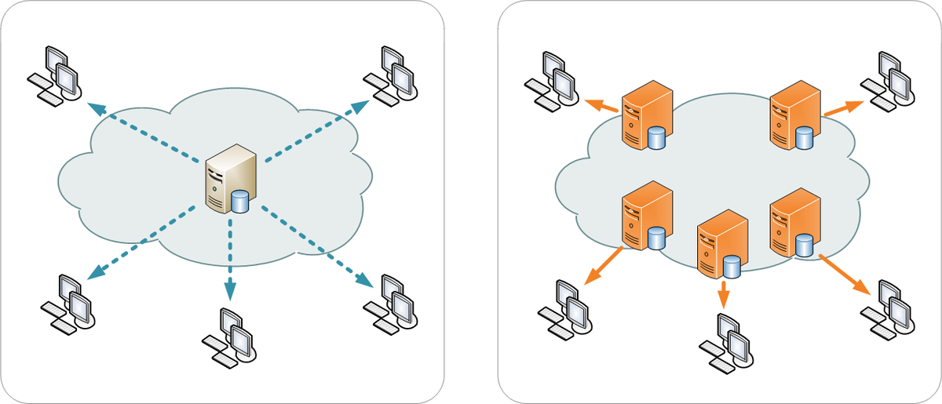
solution 5

Slide 23
solution 5
FASTER!

Slide 25
scalability and high availability DATABASE
SOLUTION #6

Slide 26
solution 6

Slide 27
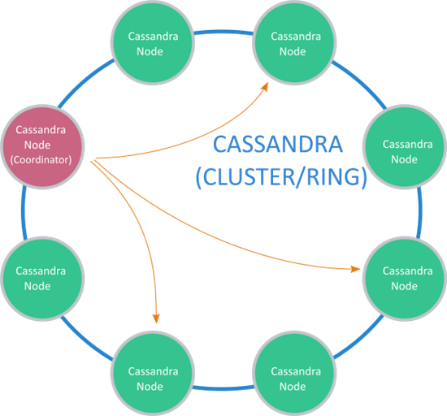
solution 6

Slide 28
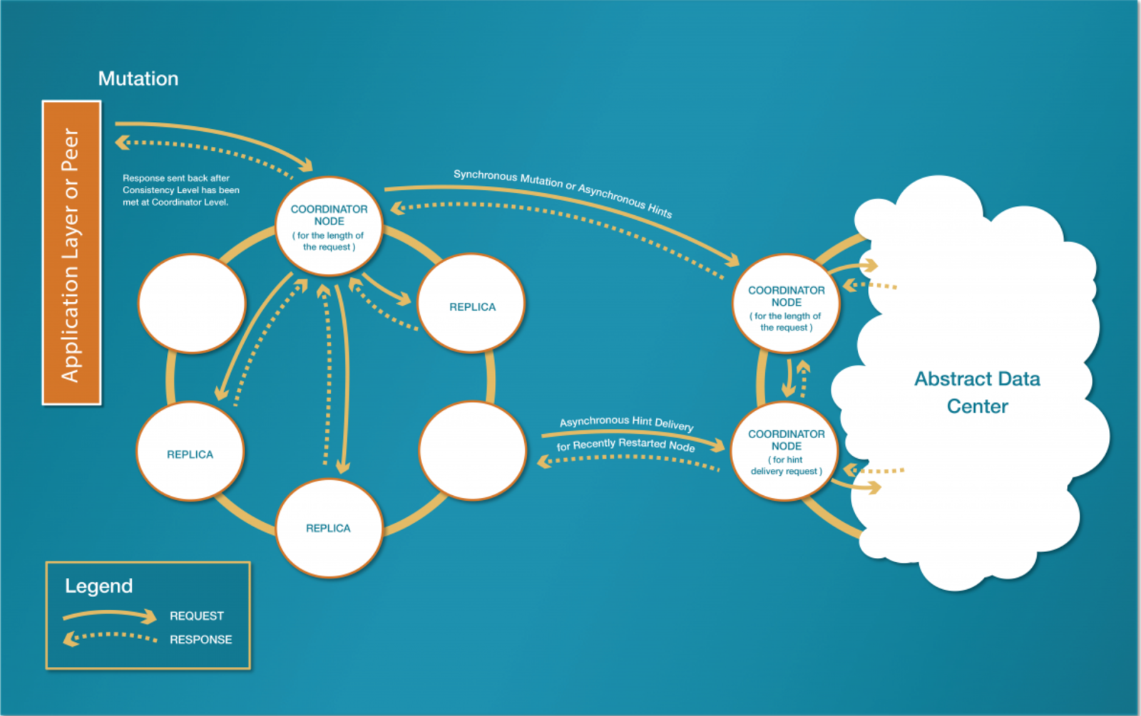
solution 6
SCALABLE & PROVEN FAULT-TOLERANCE!

Slide 29

COURSE Related
operating system 2

Slide 30
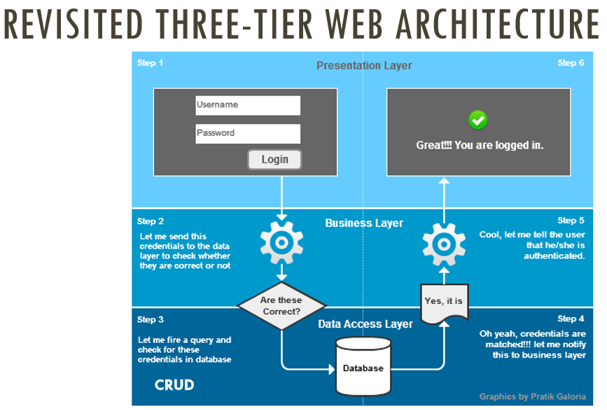
three-Tier web architecture

Slide 31
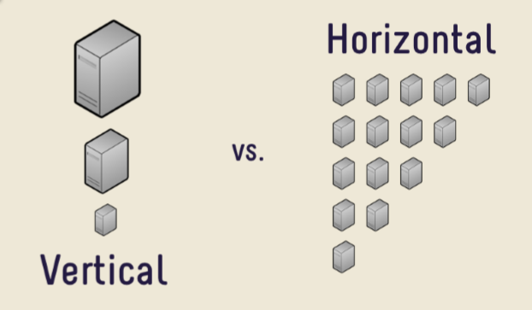
horizontal scaling

Slide 32
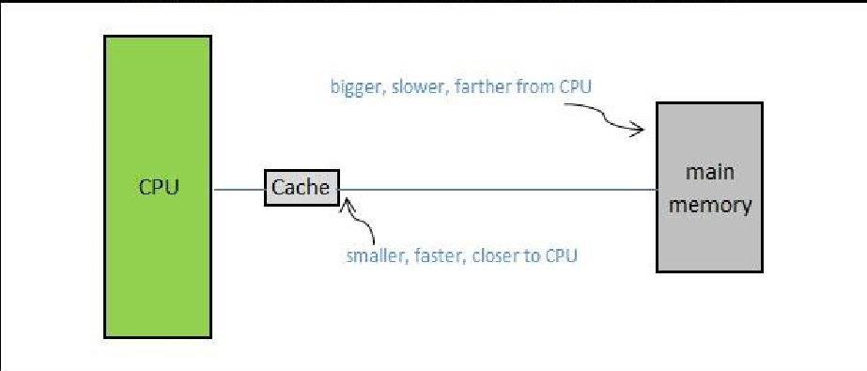
caching

Slide 33
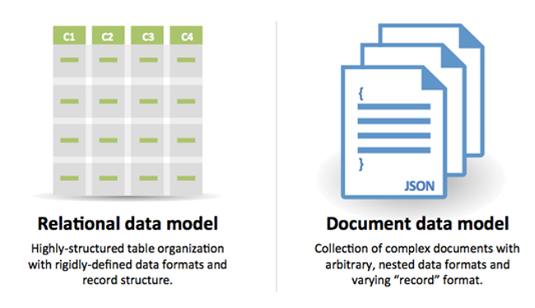
SQL & NO-SQL

Slide 34
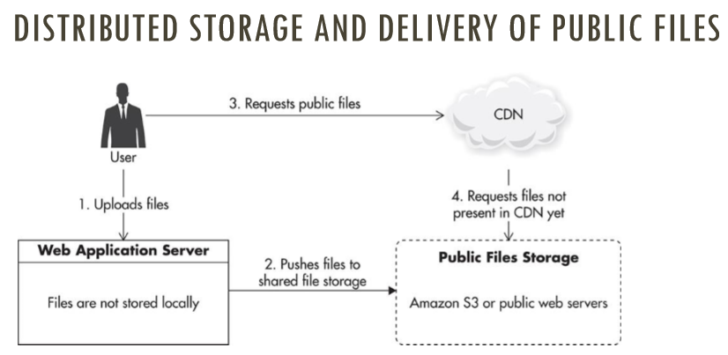
Cloud delivery network (CDN)

Slide 35
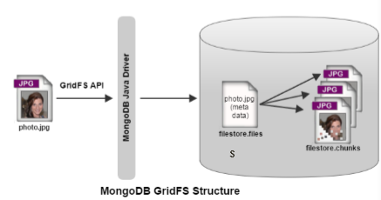
FILE managed

Slide 36
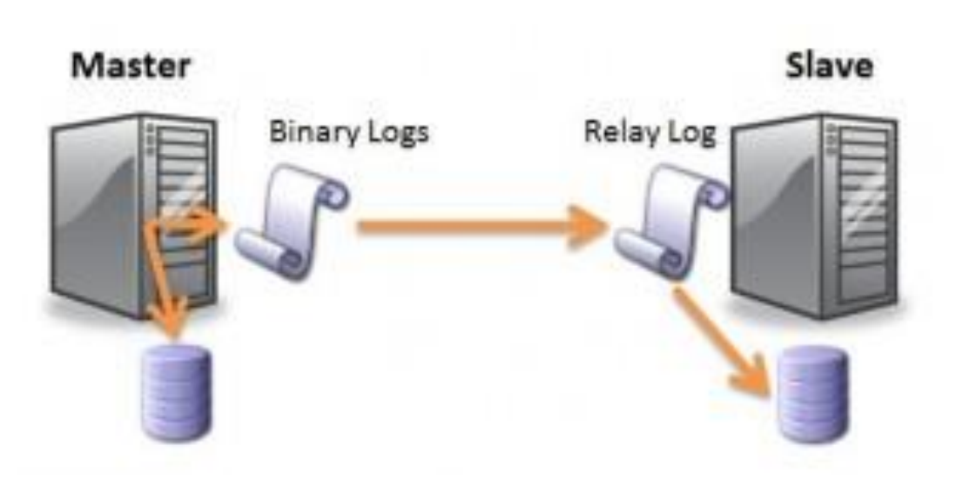
SQL Scaling

Slide 37
Q&A
Nitipat Wuttisasiwat

Slide 38
THANK YOU

